Slide 1
Paper Writing Notes
汇报人：袁尤良
日期：2021/01/27

Slide 2
Introduction of related tools
Precautions for essay writing

Slide 3
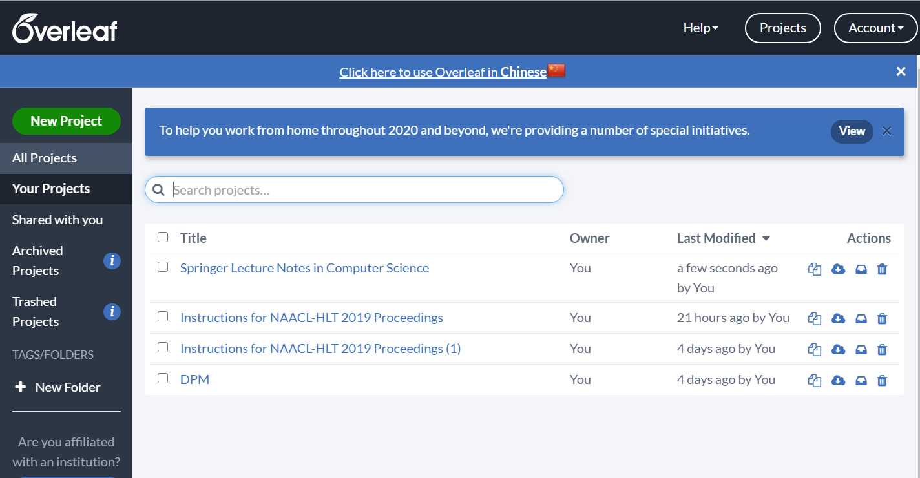
Latex Editor
online
offline
Notes:
5-shot setting
results of the table consistent with table1. Confirm effectiveness of DPM again
Analysis
Ablation Study, 1.local global use 1-shot as example 二者都有用 2. window size

Slide 4
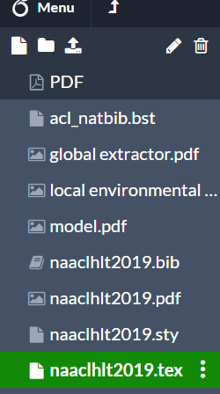
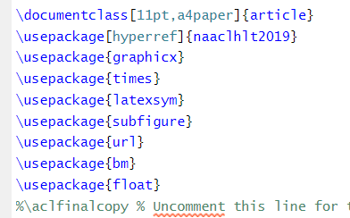
Download Template
import the usepackages
uploaded pictures
(png or pdf)
template files
Notes:
5-shot setting
results of the table consistent with table1. Confirm effectiveness of DPM again
Analysis
Ablation Study, 1.local global use 1-shot as example 二者都有用 2. window size

Slide 5
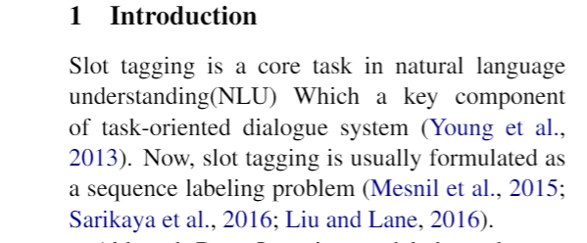
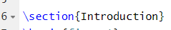
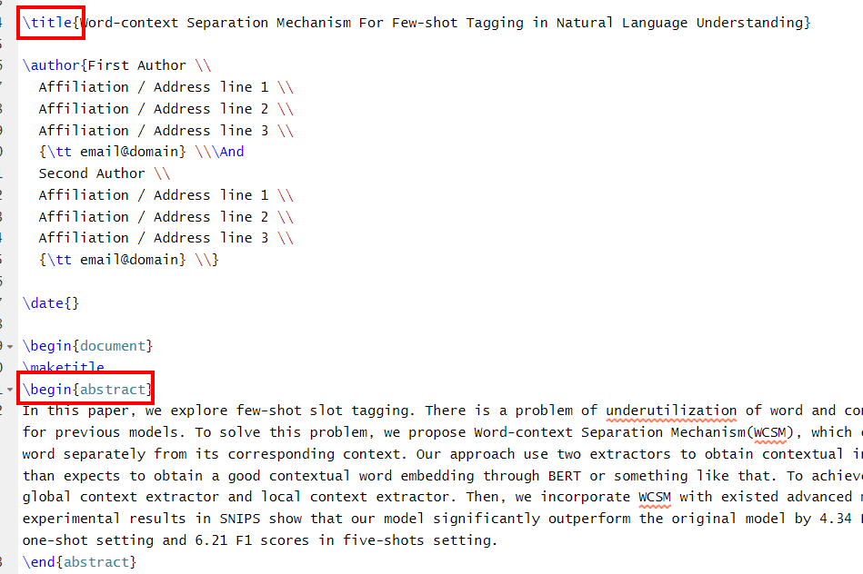
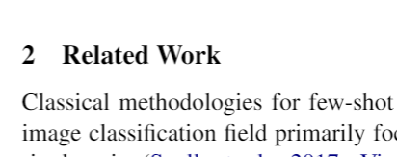
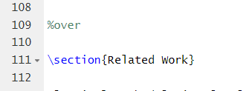
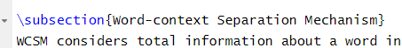
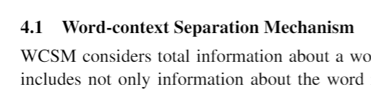
Section and Paragraph
Section
title and abstract
Subsection
Notes:
5-shot setting
results of the table consistent with table1. Confirm effectiveness of DPM again
Analysis
Ablation Study, 1.local global use 1-shot as example 二者都有用 2. window size

Slide 6
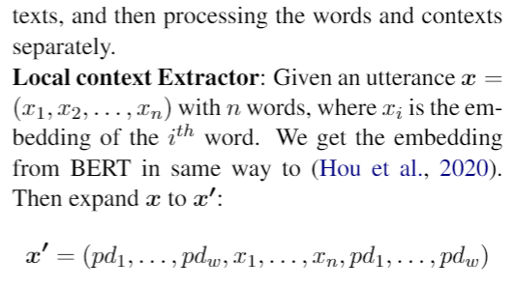
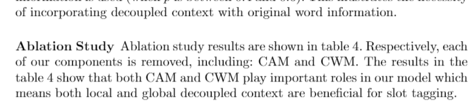
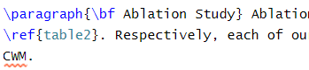
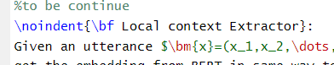
Section and Paragraph
Notes:
5-shot setting
results of the table consistent with table1. Confirm effectiveness of DPM again
Analysis
Ablation Study, 1.local global use 1-shot as example 二者都有用 2. window size

Slide 7
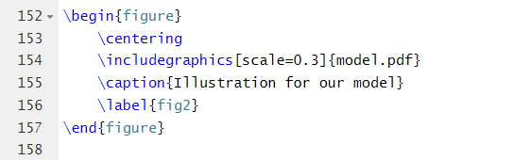
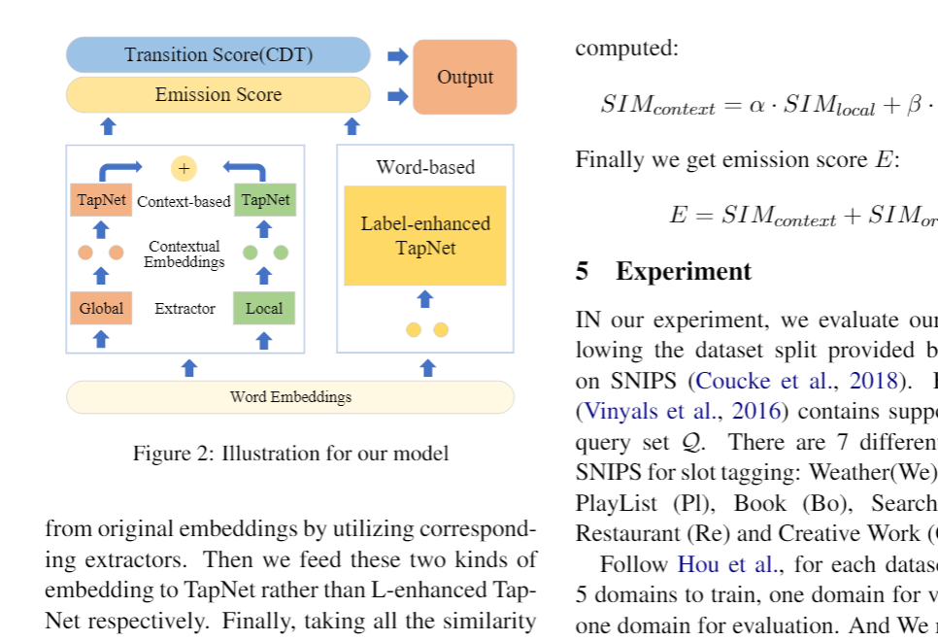
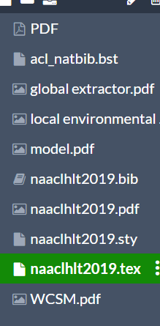
Single Figure
Notes:
5-shot setting
results of the table consistent with table1. Confirm effectiveness of DPM again
Analysis
Ablation Study, 1.local global use 1-shot as example 二者都有用 2. window size

Slide 8
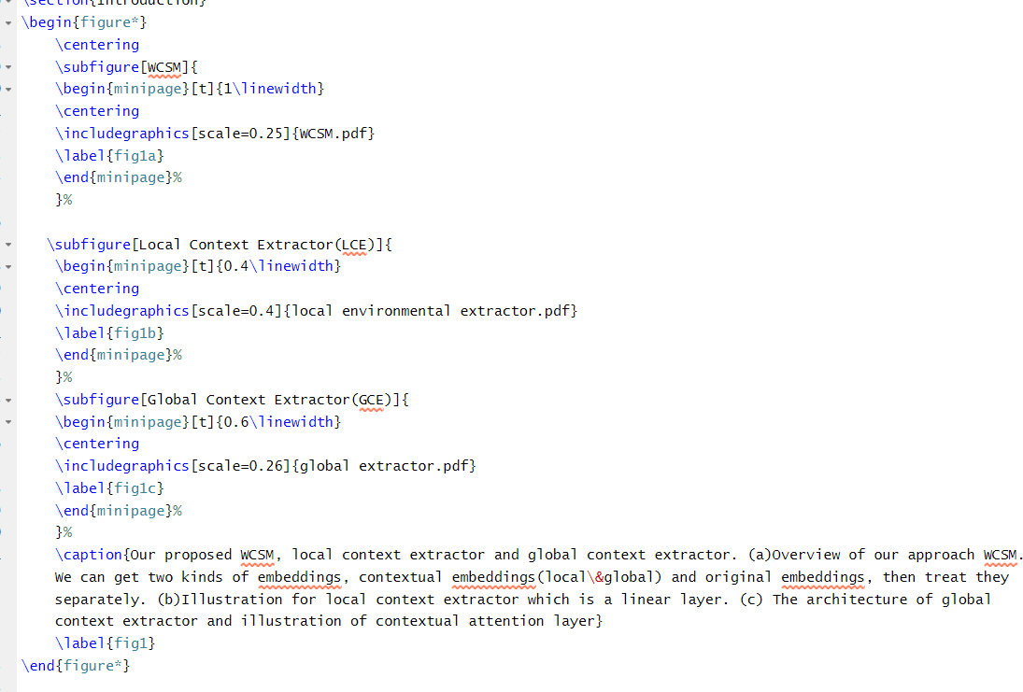
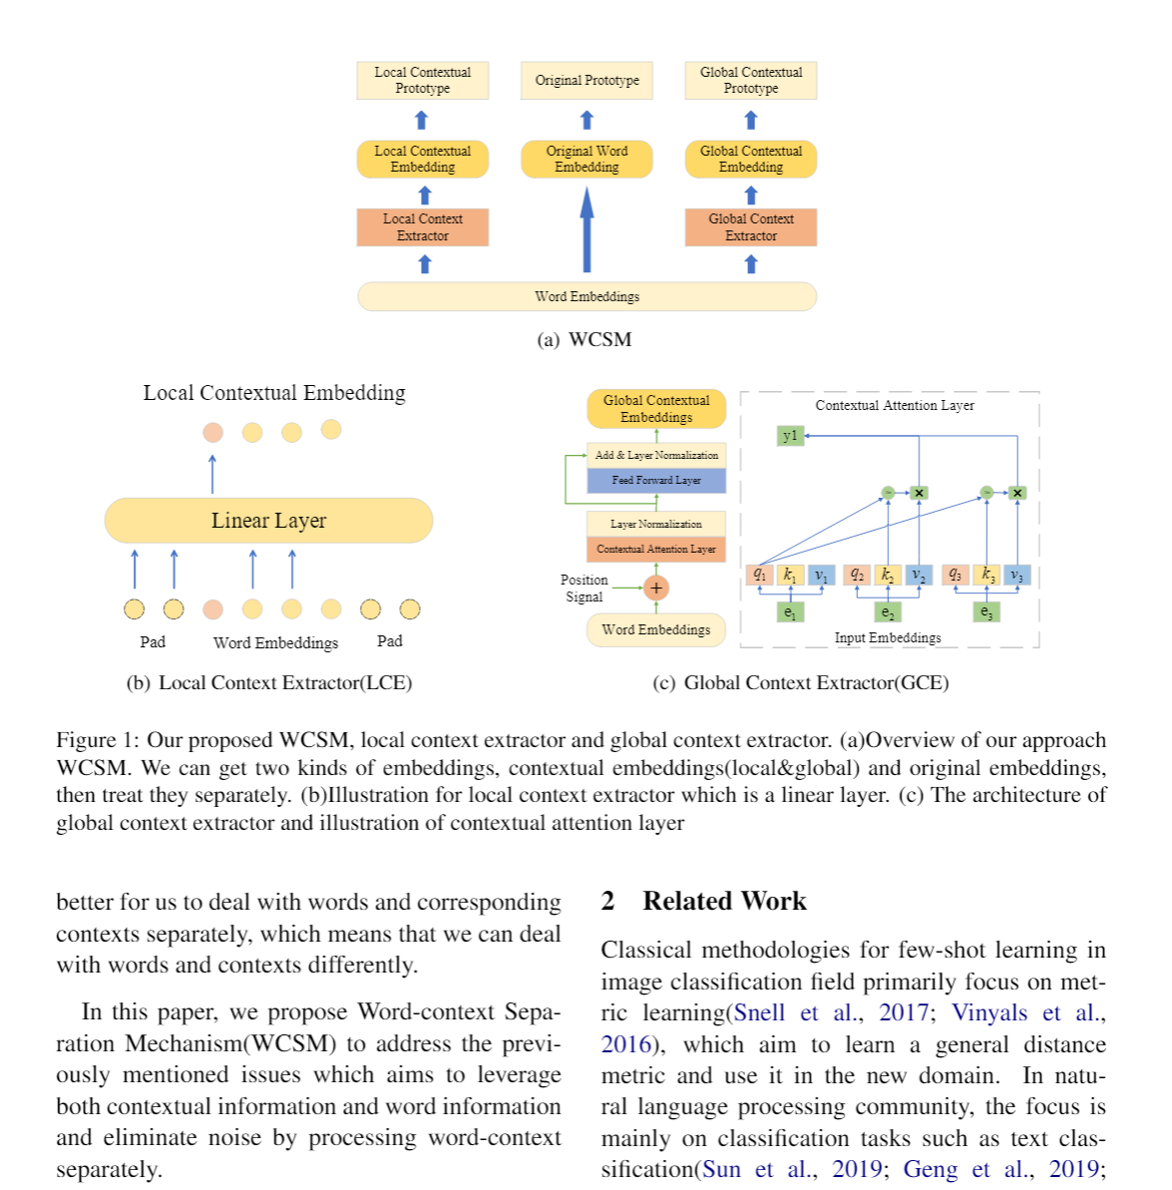
Subfigure
Notes:
5-shot setting
results of the table consistent with table1. Confirm effectiveness of DPM again
Analysis
Ablation Study, 1.local global use 1-shot as example 二者都有用 2. window size

Slide 9
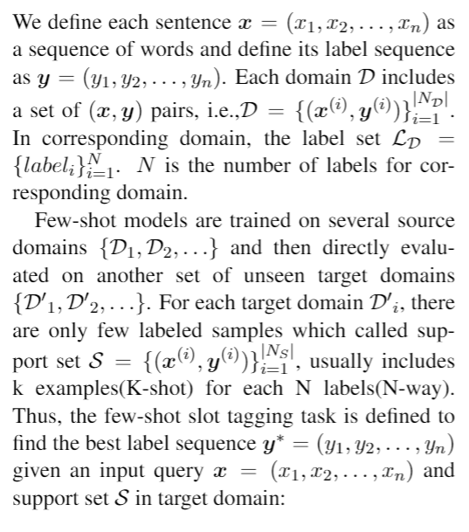
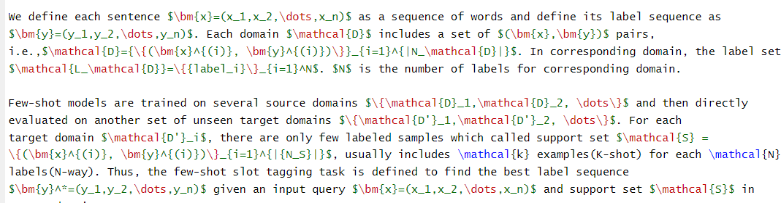
Formula
$ formula $
Subscript:”_”
Superscript:”^”
Scope:{}
Escape character:”\”
Math uppercase: “\mathcal”
Notes:
5-shot setting
results of the table consistent with table1. Confirm effectiveness of DPM again
Analysis
Ablation Study, 1.local global use 1-shot as example 二者都有用 2. window size

Slide 10
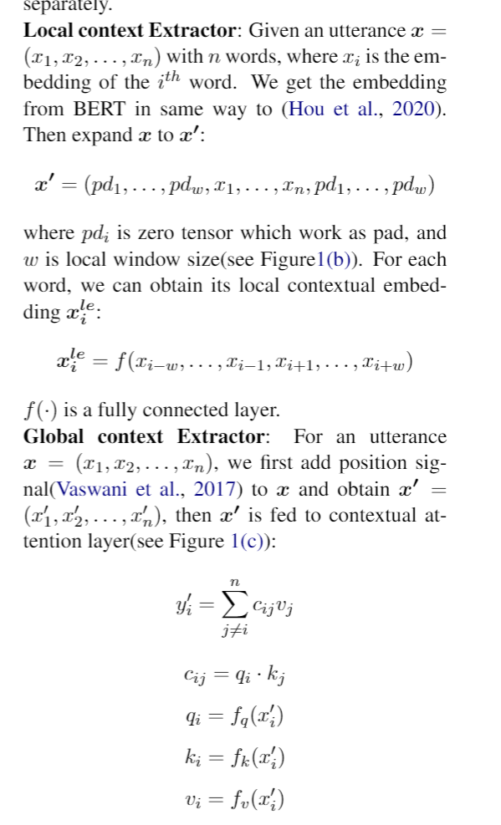
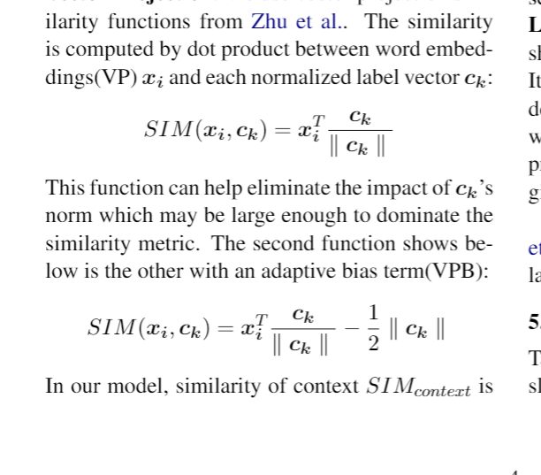
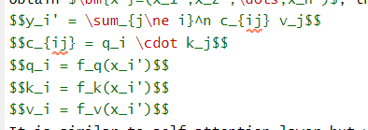
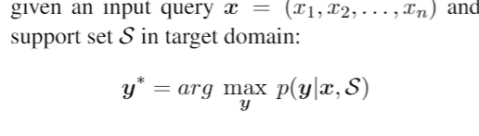
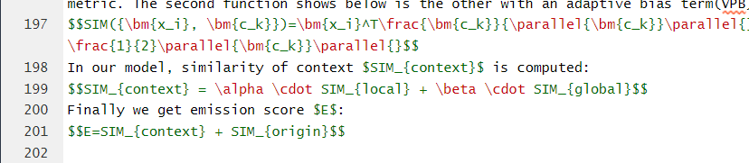
Formula
Special symbols
Notes:
5-shot setting
results of the table consistent with table1. Confirm effectiveness of DPM again
Analysis
Ablation Study, 1.local global use 1-shot as example 二者都有用 2. window size

Slide 11
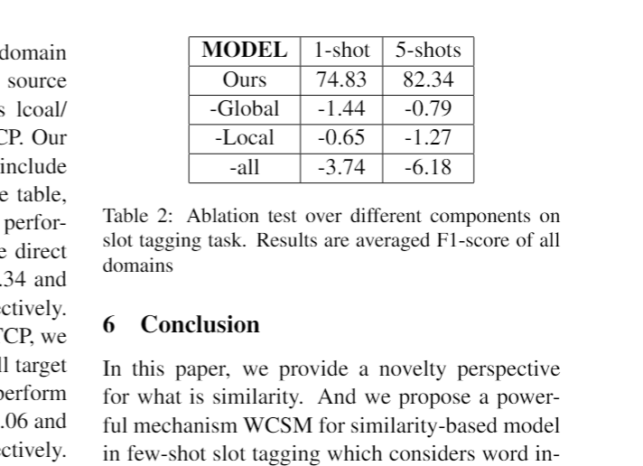
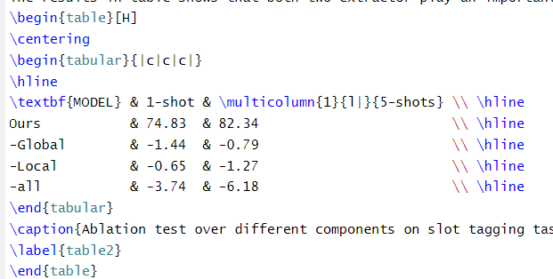
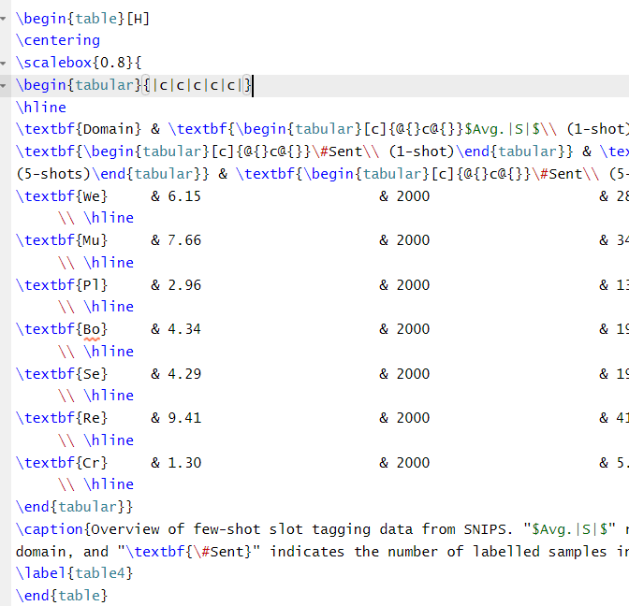
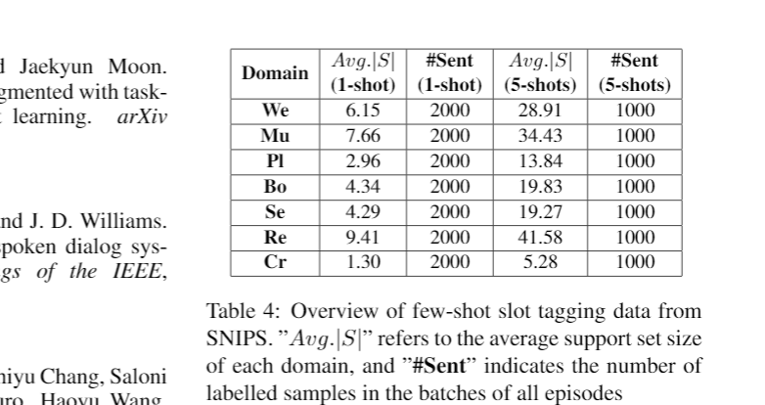
Table
[H] control the position of table
半行放不下怎么办
Notes:
5-shot setting
results of the table consistent with table1. Confirm effectiveness of DPM again
Analysis
Ablation Study, 1.local global use 1-shot as example 二者都有用 2. window size

Slide 12
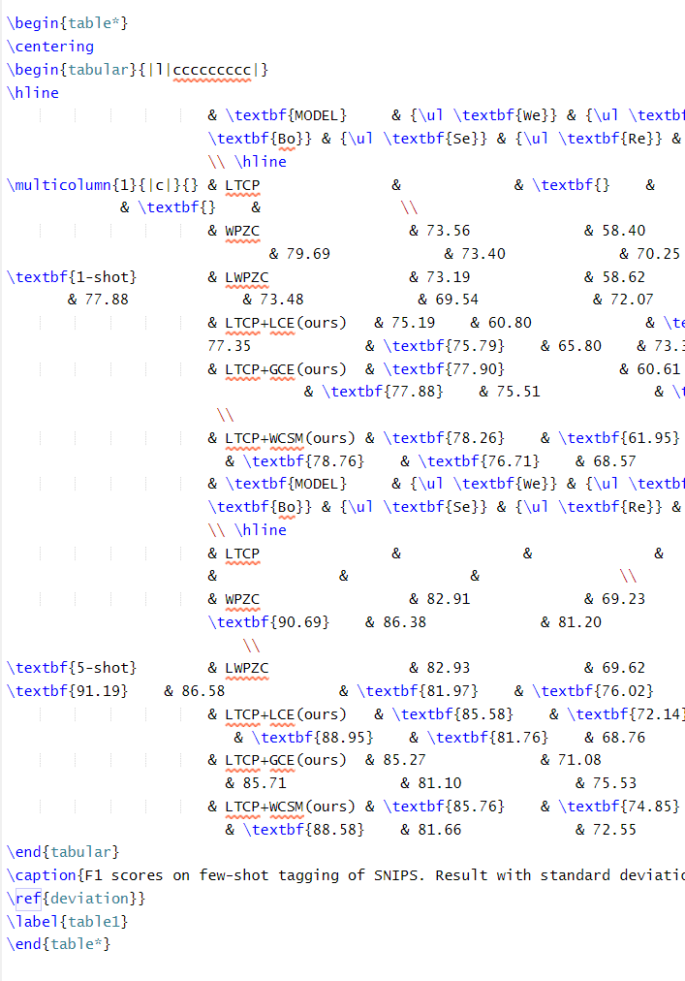
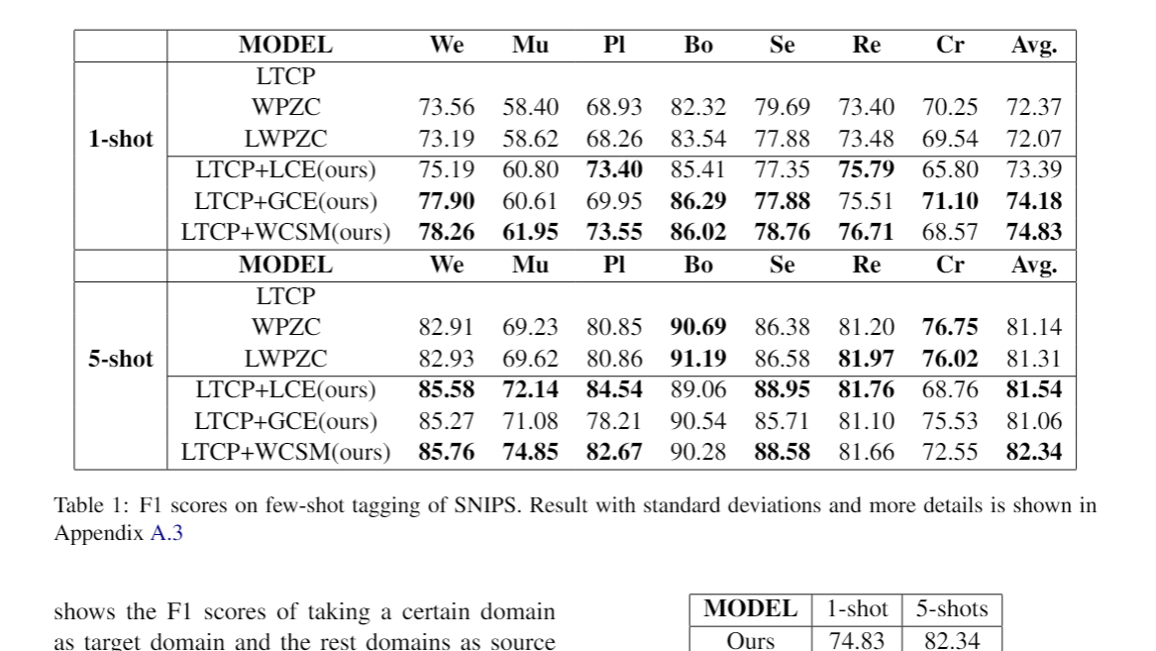
Table
Notes:
5-shot setting
results of the table consistent with table1. Confirm effectiveness of DPM again
Analysis
Ablation Study, 1.local global use 1-shot as example 二者都有用 2. window size

Slide 13
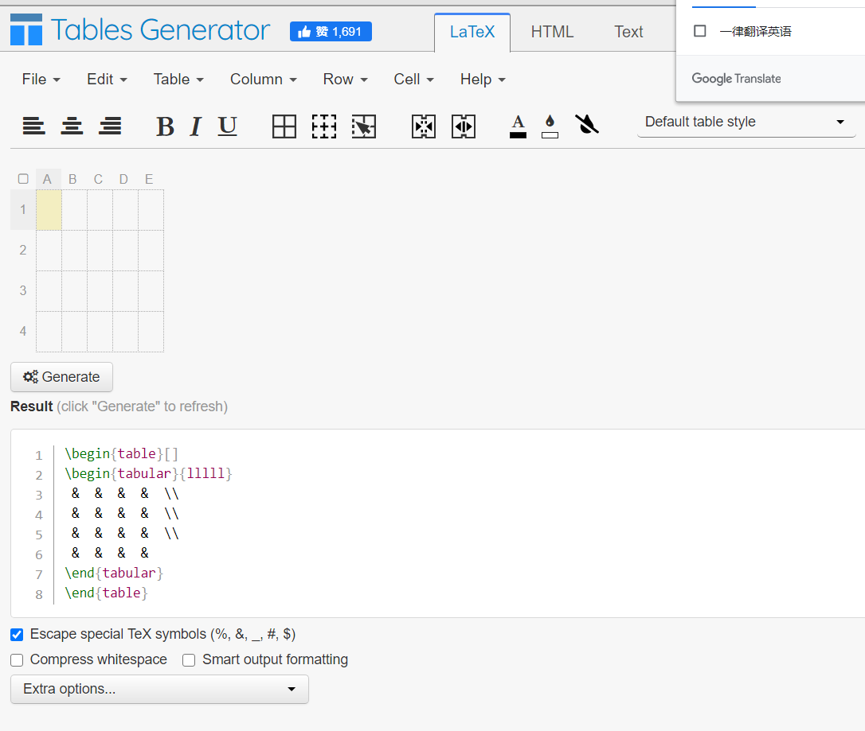
Table code generator
https://www.tablesgenerator.com/latex_tables
Notes:
5-shot setting
results of the table consistent with table1. Confirm effectiveness of DPM again
Analysis
Ablation Study, 1.local global use 1-shot as example 二者都有用 2. window size

Slide 14
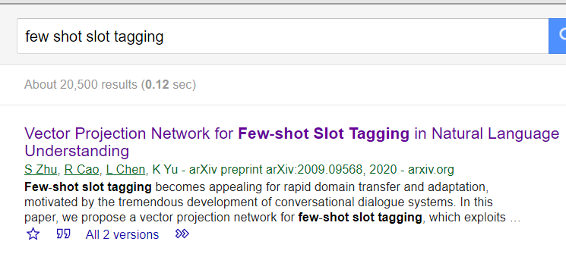
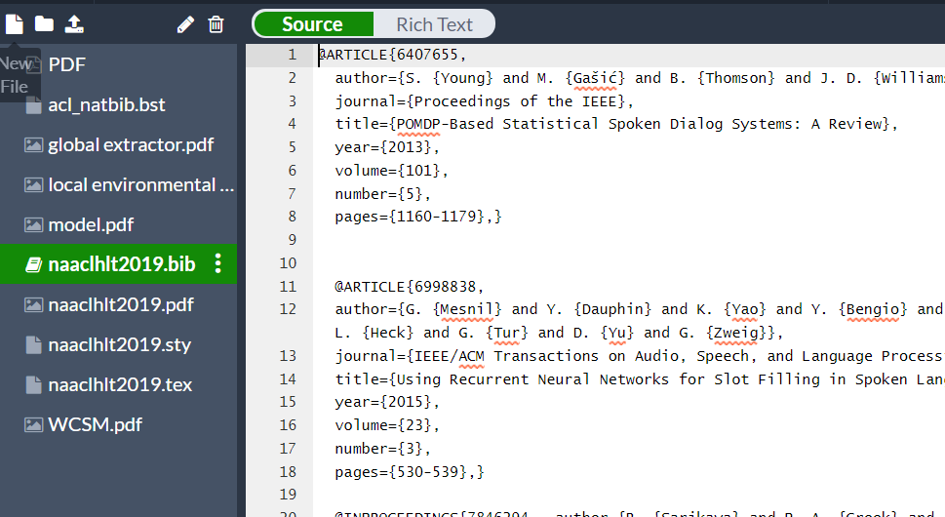
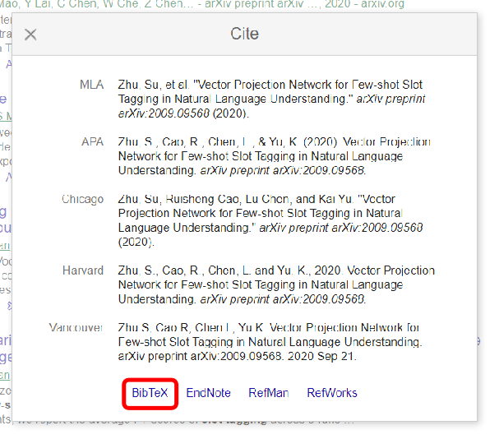
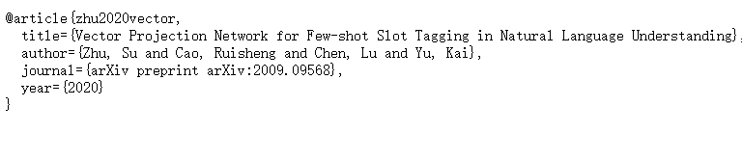
Cite Reference
Notes:
5-shot setting
results of the table consistent with table1. Confirm effectiveness of DPM again
Analysis
Ablation Study, 1.local global use 1-shot as example 二者都有用 2. window size

Slide 15
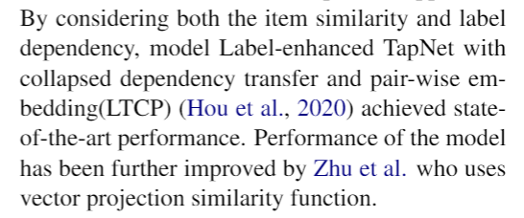
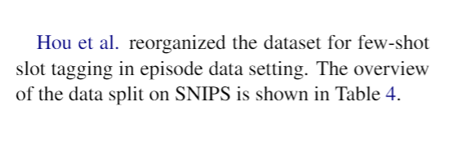
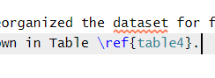
Cite Reference
Notes:
5-shot setting
results of the table consistent with table1. Confirm effectiveness of DPM again
Analysis
Ablation Study, 1.local global use 1-shot as example 二者都有用 2. window size

Slide 16
Introduction of related tools
Precautions for essay writing

Slide 17
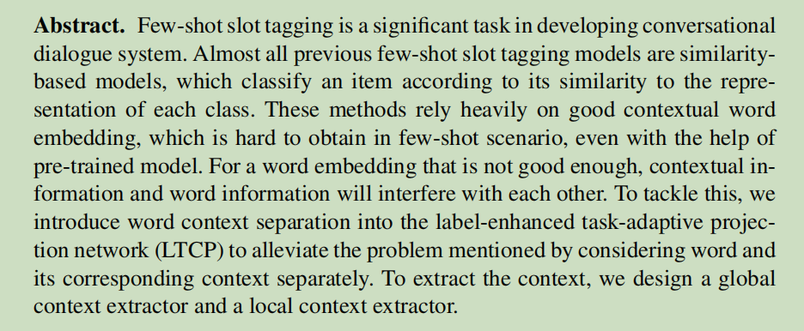
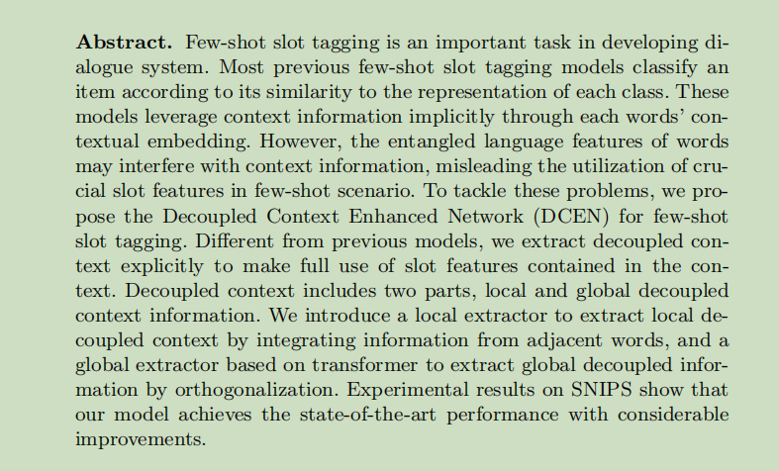
Abstract
before
after
Put more words on your work, and the introduction can’t be too simple

Slide 18
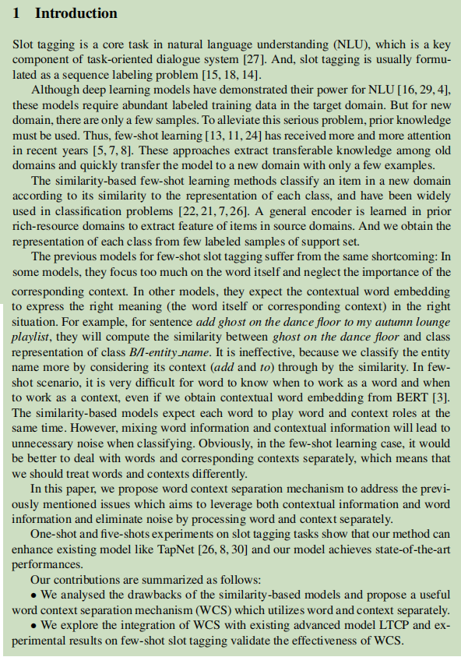
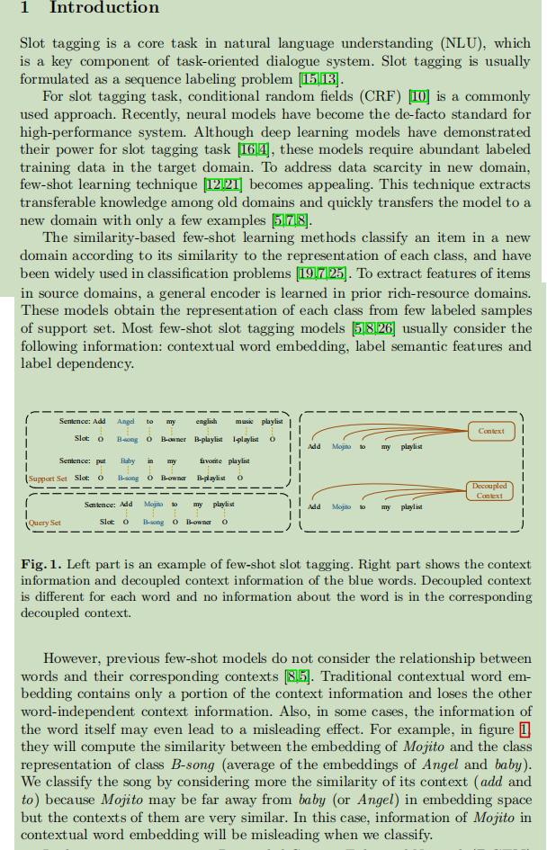
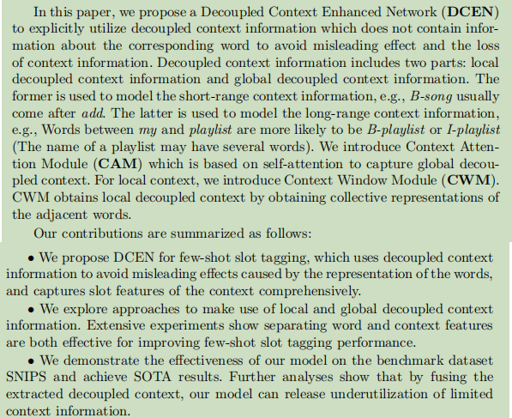
Introduction

Slide 19
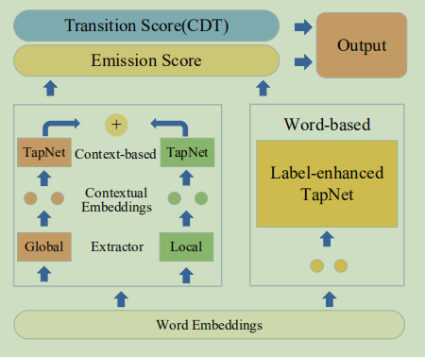
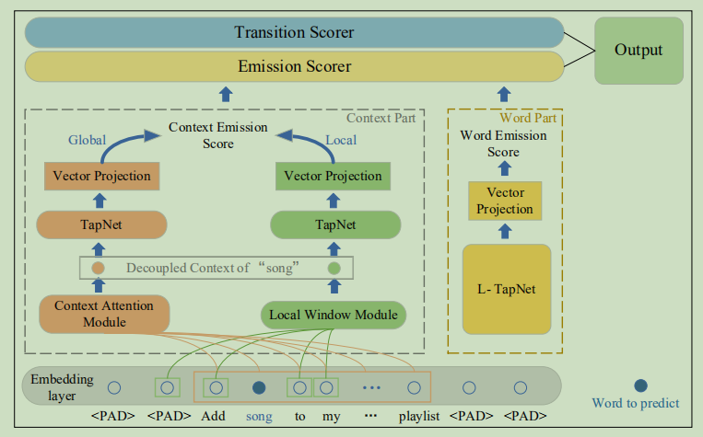
before
after

Slide 20
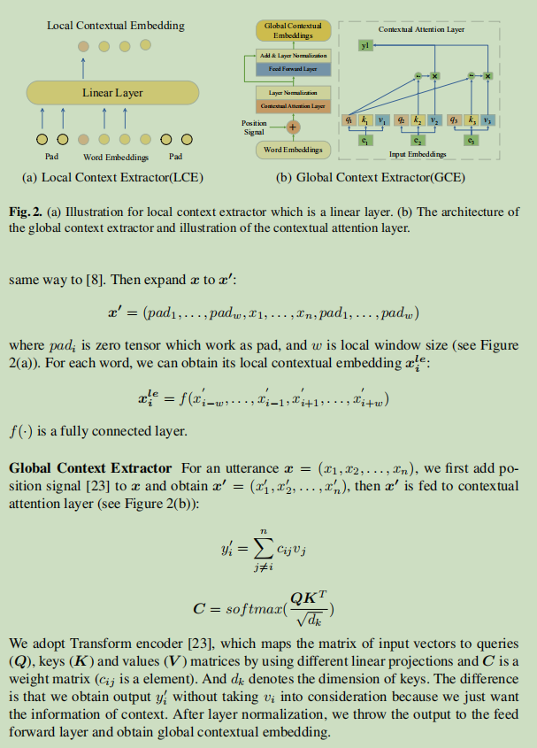
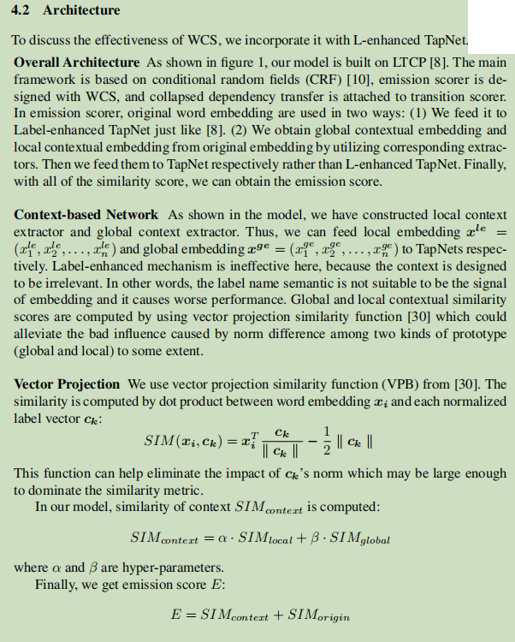
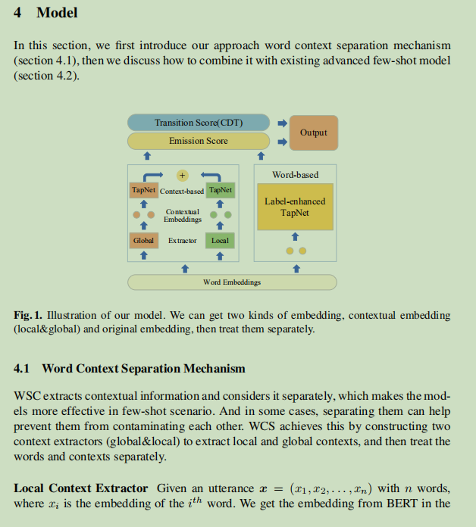

Slide 21





Slide 23
f

